Slide 1
Module 25: Configuring Applications, Screens, and Views
Siebel Core Developer and Technology School
Notes:
Time: Lecture: 45 minutes; labs: 30 minutes
Intent: To present the types of configuration that can be done to application, screen, and view object definitions.
Flow: Specify the Application object. Configure menus and screen tabs. Add views to screens. Configure where views will appear in the Siebel application. Create views using the wizard. Register and assign views to responsibilities.
Key Terms:
Container page
Menu
Screen tab
Screen view
Aggregate category
Aggregate view
Detail category
Detail view
Screen Layout Editor
Registering views
Assigning views to responsibilities
Please note: Faculty-specific notes are italicized.

Slide 2

Module Objectives
After completing this module you will be able to:
  Tailor applications
  Configure how a view is accessed on a screen
  Change the order of screen views for a screen
  Create and administer a view
  Associate a view with a template
Why you need to know:
  You may wish to modify the user interface

Slide 3
Logical User Interface
Specifies the layout of the Siebel application
Consists of
  Applications
  Screens
  Views
  Applets
  Controls/list columns
Focus of this module
List Column
or Control
Applet
View
Screen
Application
Notes:
This is a review of the UI layer of the object model.

Slide 4
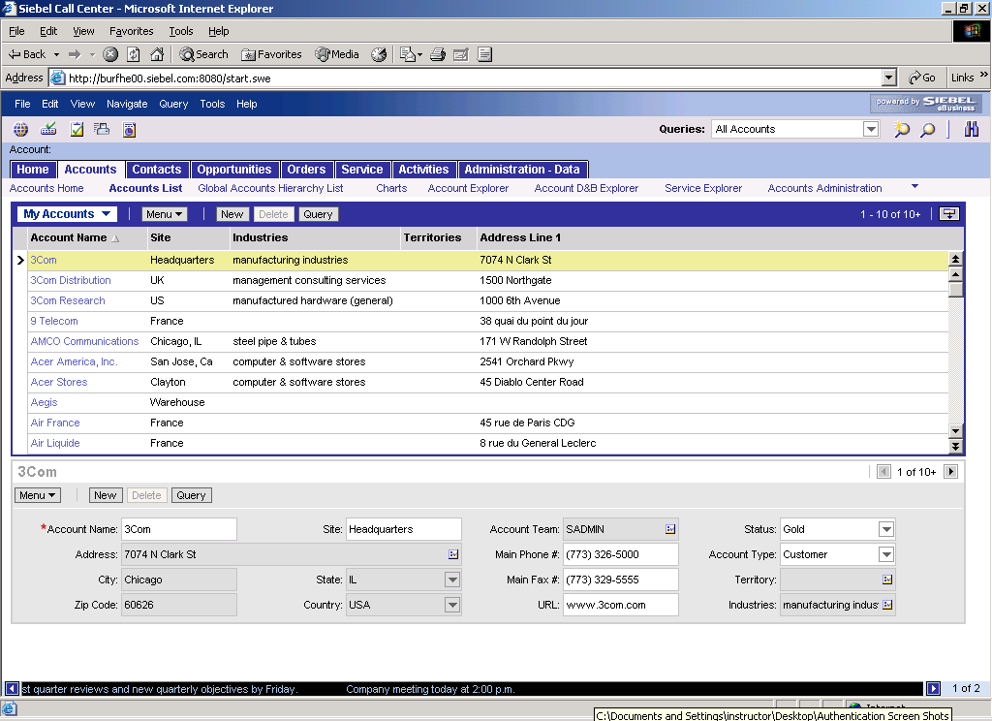
Applications
Use a container page to display the Siebel Web page
Specify the application-level menus
Are collections of screens through which users can navigate
Container page

Slide 5
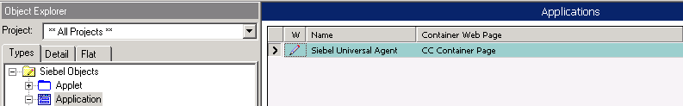
Specifying the Container Page
The container page is specified in the Application object definition
Container Web Page: Specifies the container page
Notes:
The container page is a Web page that displays the menus, toolbars, screen tabs, and views that appear in the application.

Slide 6
The Container Page: Employee Application
Container page specifies the layout of the application
Application- level menu
Toolbar
Screen tabs
Link bar
View
Notes:
The container page for an employee application should be familiar to the students, as they have been using Siebel Call Center throughout the course.
The callouts highlight items that will be discussed in more detail in the rest of the module.

Slide 7
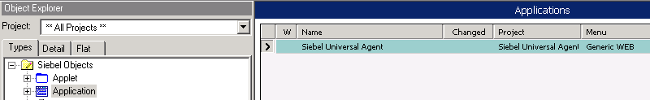
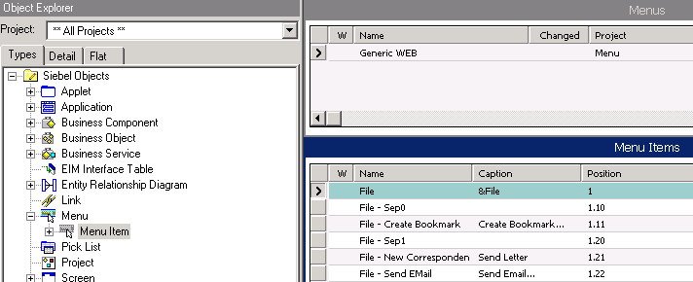
Application-Level Menus
Are specified in the Menu object type
  For example, Call Center uses the Generic WEB menus
Application-level menu
Position: Specifies order of appearance
Caption: Specifies displayed text
Notes:
The example describes how to specify the caption and order of appearance of menu items using Siebel Tools.

Slide 8
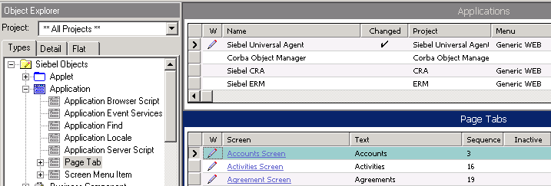
Screen Tabs
Contain links to screens
Are defined as page tabs
  Child object of the application
Text: Specifies text that appears on page bar
Sequence: Specifies initial page tab order appearance in screenbar
Notes:
The example describes how to specify screen tabs using Siebel Tools.

Slide 9
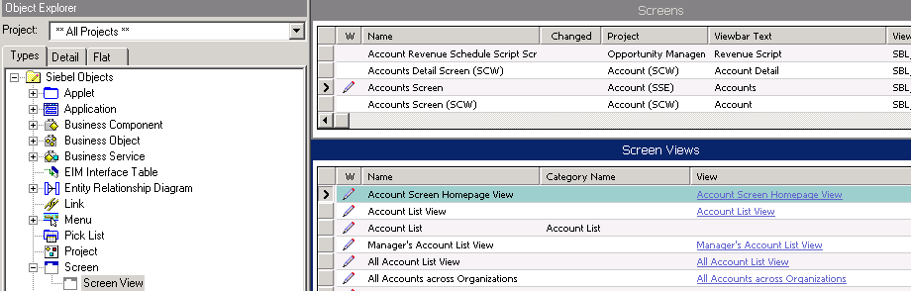
Screens
Have a child object type of Screen View
  Specify the views and categories that will appear in the screen
Notes:
Screen views will be discussed in more detail in subsequent slides.

Slide 10
Screen View Properties
Viewbar Text: Defines the text that appears in the UI
Menu Text: Defines the text that appears in the Site Map
Type: Defines how users navigate to views within the screen
  Aggregate Category
  Aggregate View
  Detail Category
  Detail View
Notes:
This slide details configuration of menu text and viewbar text using Siebel Tools.
This slide also introduces the types of screen views that will be named in the next five slides.

Slide 11
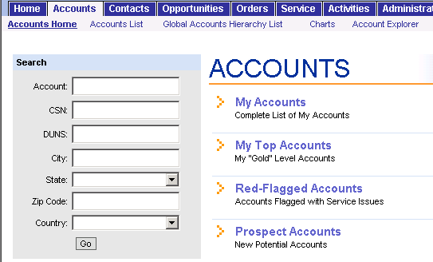
Aggregate Categories
May contain aggregate views, detail views, and detail categories
  Category Name is referenced by views contained within
Do not specify a view
  Category default view is displayed when link is selected
  If no default view is specified, first view in sequence will appear
Aggregate Category
Notes:
Aggregate categories appear in the link bar. They are not views. They are instead groups of views to which the user can navigate.
For example, users who wish to see Account data may select Accounts List from the link bar. This would navigate them to a group of views, including views such as My Accounts, My Team’s Accounts, and All Accounts, as well as the Account Detail - Contacts View and other detail views.
Aggregate categories may specify a Category Default View. This is the view to which users are navigated when they select the aggregate category. For example, when users select the aggregate category Accounts List, they are navigated to the My Accounts view by default.
If no category default view is specified, or if the user does not have access to the category default view, selecting the aggregate category will navigate the user to the first view in the sequence of the screen for that category.
An example of an aggregate category is Accounts > Accounts List. This example will be used in the next four slides.

Slide 12
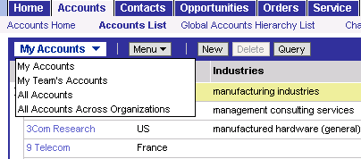
Aggregate Views
Appear in the link bar or visibility filter drop-down
May belong to an aggregate category
Aggregate view
without parent category
property specified
Aggregate views
with parent category
of accounts list
Notes:
Aggregate views may appear in the link bar along with aggregate categories. Screen home pages such as the Accounts Home view are examples of aggregate views. Aggregate views are not part of a category, but may contains links to other views in the application.
Screen home pages are not discussed in more detail in this class.
Aggregate Views that reference Access Control (such as My Accounts and My Team’s Accounts) typically belong to an aggregate category. These views appear in the visibility filter drop-down list.
Examples of aggregate views include Accounts > Accounts Home and Accounts > Accounts List > My Accounts.

Slide 13
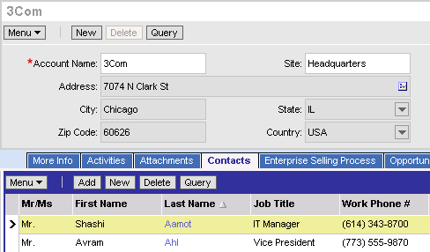
Detail Views
Appear in the view tab bar if the parent category specifies an aggregate category
Detail views in the
Accounts List
aggregate category
Notes:
Detail views that belong to an aggregate category appear in the view bar tab.
An example of a detail view can be found in Accounts > Accounts List > Contacts.

Slide 14
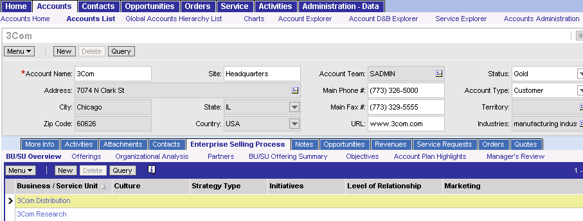
Detail Categories
Appear in the view tab bar
Belong to an aggregate category
Do not specify a view
Parent Category property
is set to the Accounts List
aggregate category
Detail Category
Notes:
Detail categories are collections of detail views. Detail Categories appear in the view bar.
An example of a detail category may be found in Accounts > Accounts List > Enterprise Selling Process.

Slide 15
Detail Categories Continued
Display detail views
  In a separate link bar below the view tab bar, or
  As a view tab on a grandchild applet
May be the parent category for detail views
Detail category
Detail view
Notes:
Detail categories and detail views that belong to an aggregate category appear in the view bar. Detail views that belong to a detail category appear in a link bar below the view bar. An example of a detail category may be found in Accounts > Accounts List > Enterprise Selling Process > BU/SU Overview.

Slide 16
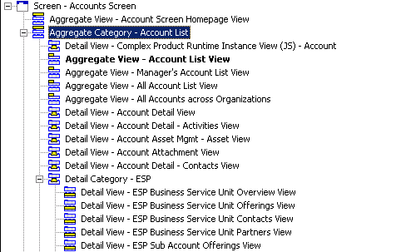

Sequence Editor
Assists you in defining where your view appears in the application
  Updates the sequence property of the screen view object definition
Right-click to edit
the sequence
Notes:
The Screen View Sequence Editor sets the sequence property for screen views. It indents the screen views for Aggregate Categories, Aggregate Views, Detail Views and Detail Categories to help the developer visualize where they will appear.
The sequence editor is used to determine the placement of the screen view in the appropriate UI element. The higher the position of the view or category, the further left in the link bar or view bar (or higher in the visibility filter drop-down list) the link to the view or category will appear.

Slide 17
Views
Consist of one or more applets
Reference a business object that defines the relationships between data in the view
Are associated with a Web template that defines their layout
Notes:
Views are containers for applets. The rest of the module will focus on creating and administering views.

Slide 18
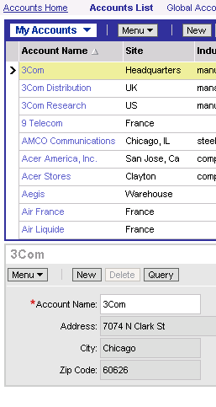
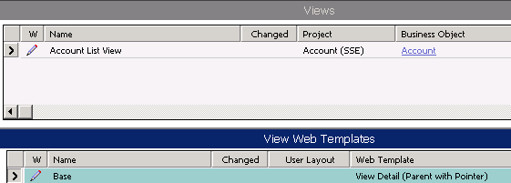
Selecting a View Template
Find an existing view that has desired applet layout
Examine the view template object definition to determine the view template to use
The Account list view…
…uses the template
View Detail (Parent with Pointer)
Notes:
The Account List View uses the View Detail (Parent with Pointer) template that will be used in the following slides.

Slide 19
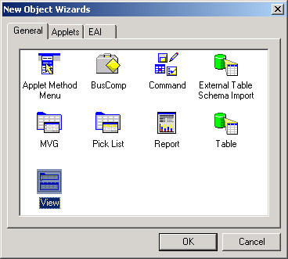
View Wizard
Use the View wizard to create a new view and assign applets
  Select File > New Object
Notes:
In this course, we will be configuring a lot through wizards instead of building the definitions directly. Using wizards is much easier and more foolproof (reducing the risk of errors).

Slide 20
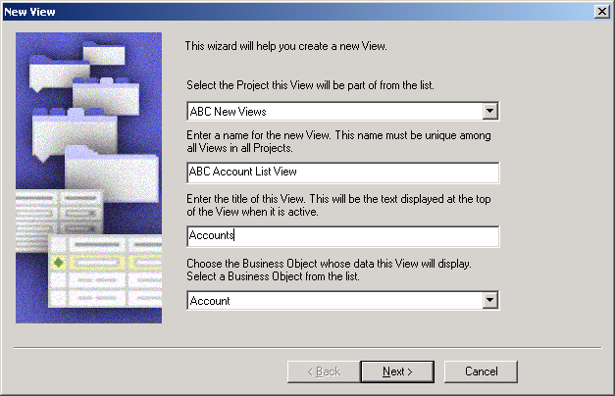
View Wizard Continued
Select the project and business object and enter the name and title of the view

Slide 21
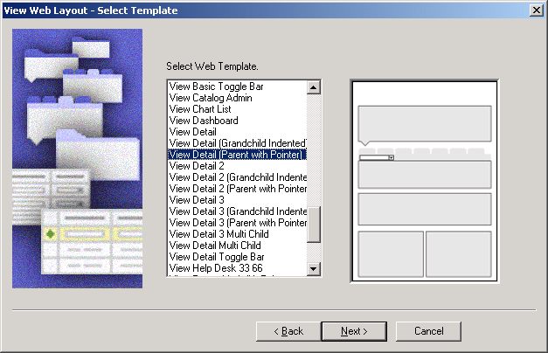
View Wizard Continued
Select a Web template

Slide 22
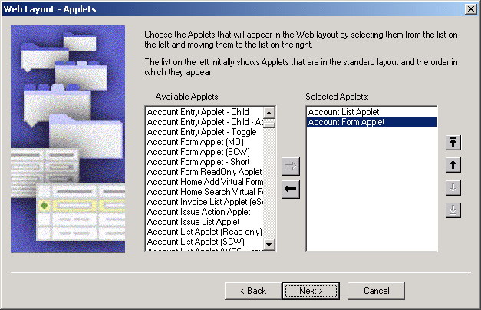
View Wizard Continued
Assign applets to the view
Notes:
Select an applet in the Available Applets list and click the right arrow to move it to the Selected Applets list. Selected applets will appear in the view, and the order in the list determines the order in which they are added to the view. Use the arrows to move applets up and down in the Selected Applets list.

Slide 23
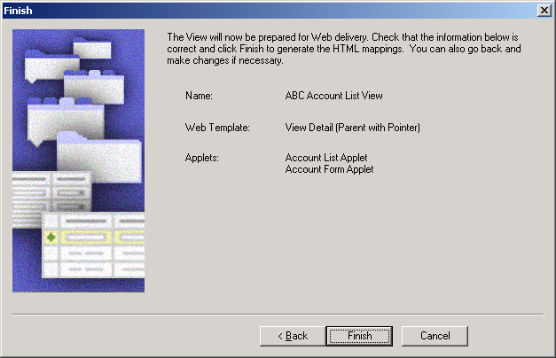
View Wizard Continued
Finish and launch the View Web Layout Editor

Slide 24
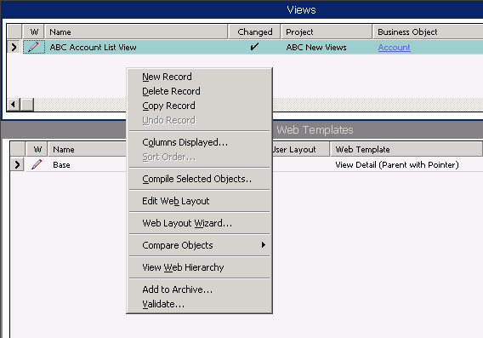
Web Layout Editor
Is launched by the View wizard
Can also be launched by right-clicking a view
Right-click and select Edit Web Layout
Notes:
The students have already used a Web Layout Editor for list and form applets, so this should be a familiar concept.

Slide 25
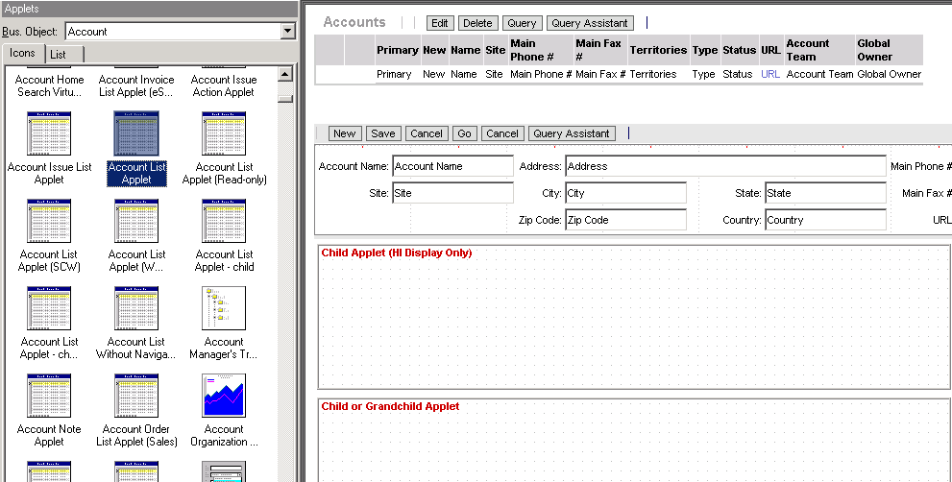
Web Layout Editor
Displays the current layout of the view
Applet window shows available Applets for display within the view
  Constrained by the business object of the view
1. Drag applet from Applet window
2. Drop onto applet placeholder
Notes:
The Applets window contains applets based on the business object of the view.
If a new applet does not appear in the applets window, it is possible that the applet uses a business component which is not part of the business object for the view. It is also possible that the Applets window has cached the list of available applets. To refresh the cache, select the Bus Object drop-down at the top of the Applets window and select another business object. The window should refresh. Open the list again and select the appropriate business object. The window should refresh with a list of all applets for the selected business object.

Slide 26
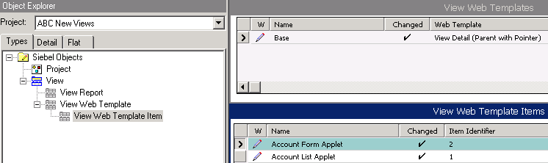
View Web Template Items
Are applets that have been bound to a view
  Item identifier specifies where they are to appear
Notes:
The Item Identifier property of the View Web Template Items specifies the placeholder where the applet will appear.
The Mode property specifies the mode in which the applet will appear. For high interactivity applications, form applets should be displayed in Edit mode, and list applets in EditList mode.

Slide 27
Register and Assign View
Views must be administered in the client application to make them available to users
  Register the view
  Assign the view to one or more responsibilities
Notes:
The next two slides explain how to register and assign views to responsibilities.

Slide 28
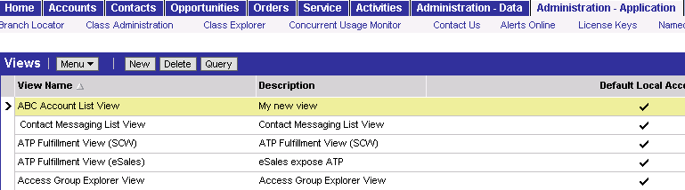
Register and Assign View Continued
Select Site Map > Administration – Application > Views in the client application
  Copy and paste view name from object definition in Tools to the view record
Notes:
Registering a view creates a database record to which Responsibilities can refer. Responsibilities do not reference views in the repository or the .srf file directly, but instead reference views that appear in this list.

Slide 29
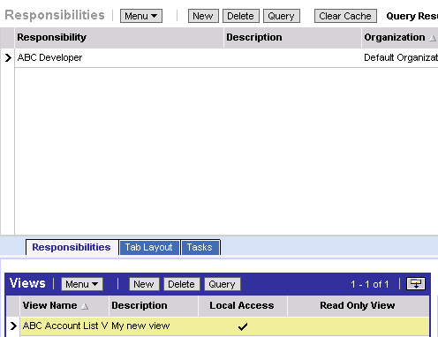
Register and Assign View Continued
Select Site Map > Administration – Application > Responsibilities in the client application
  Assign the view to developers for unit testing
  Assign the view to users for system testing and production
Notes:
Assigning a view to a responsibility makes the view visible to users that share that responsibility. If a view has not been registered, it cannot be added to a responsibility. If a view has not been added to the developer’s responsibility, they will not be able to unit test the view.

Slide 30
Summary
This module showed you how to:
  Tailor applications
  Configure how a view is accessed on a screen
  Change the order of screen views for a screen
  Create and administer a view
  Associate a view with a template
Notes:
Review Question: Which object specifies a container page?
Answer: The application
Review Question: What types of screen views may appear in the link bar?
Answer: Aggregate categories and aggregate views

Slide 31
Lab
In the lab you will:
  Create a view
  Add the view to a screen using a specified view navigation mechanism
  Administer the new view
Notes:
See the lab instructions for more details.
Please note: There is not a solution document for this lab.

